Slide 1
Functional Programming

Slide 2
Algorithms + Data Structures = Programs

Slide 3
Function
Function vs Methods ?

Slide 4
Pure Function

Slide 5
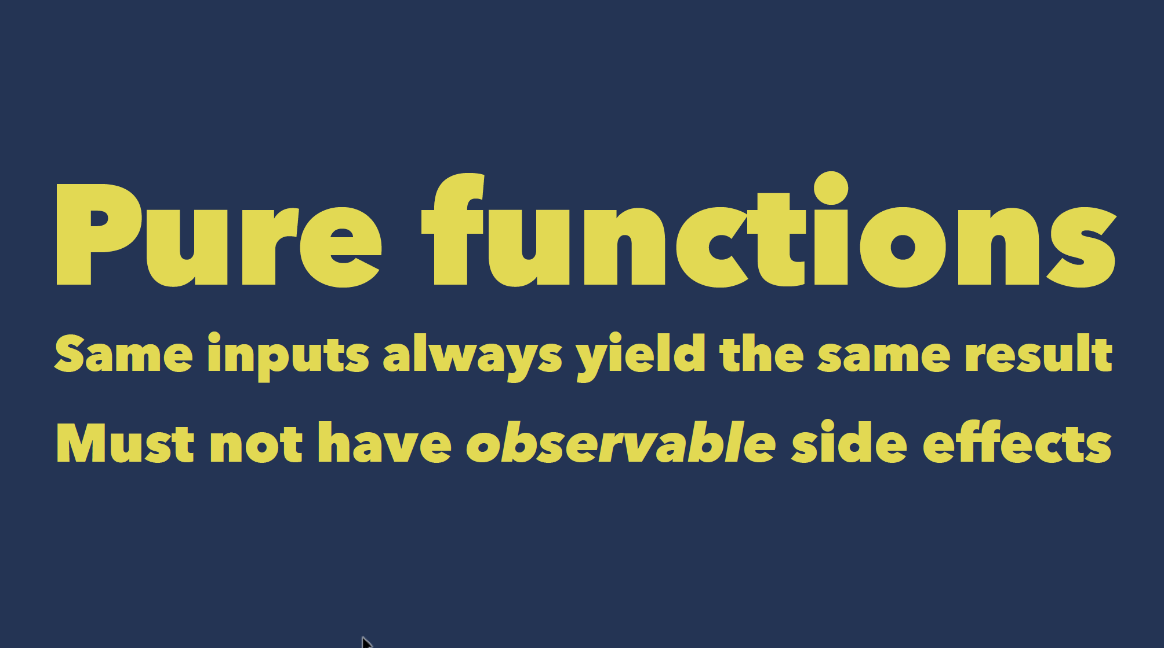

Slide 6
First Class Function

Slide 7
Closures
Block – Objective – C
Lambdas
Closures – Swift
…

Slide 8
Closures
In Swift Function is Closures

Slide 9
Higher Order Function

Slide 10
Currying Function

Slide 11
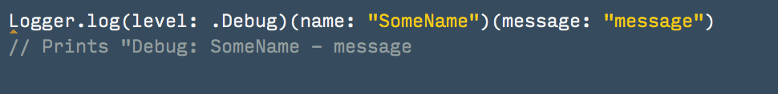
Currying Function

Slide 12
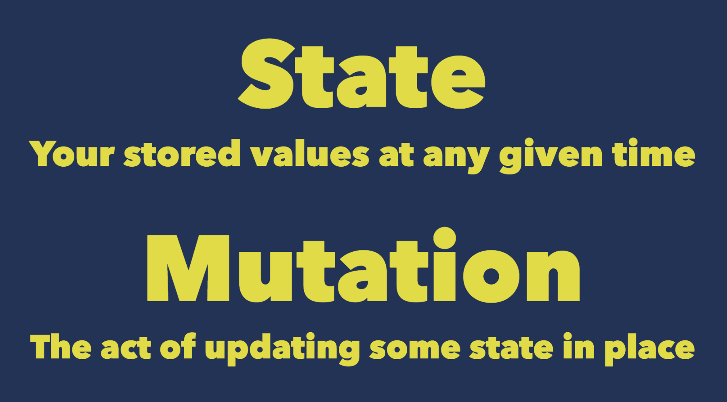

Slide 13
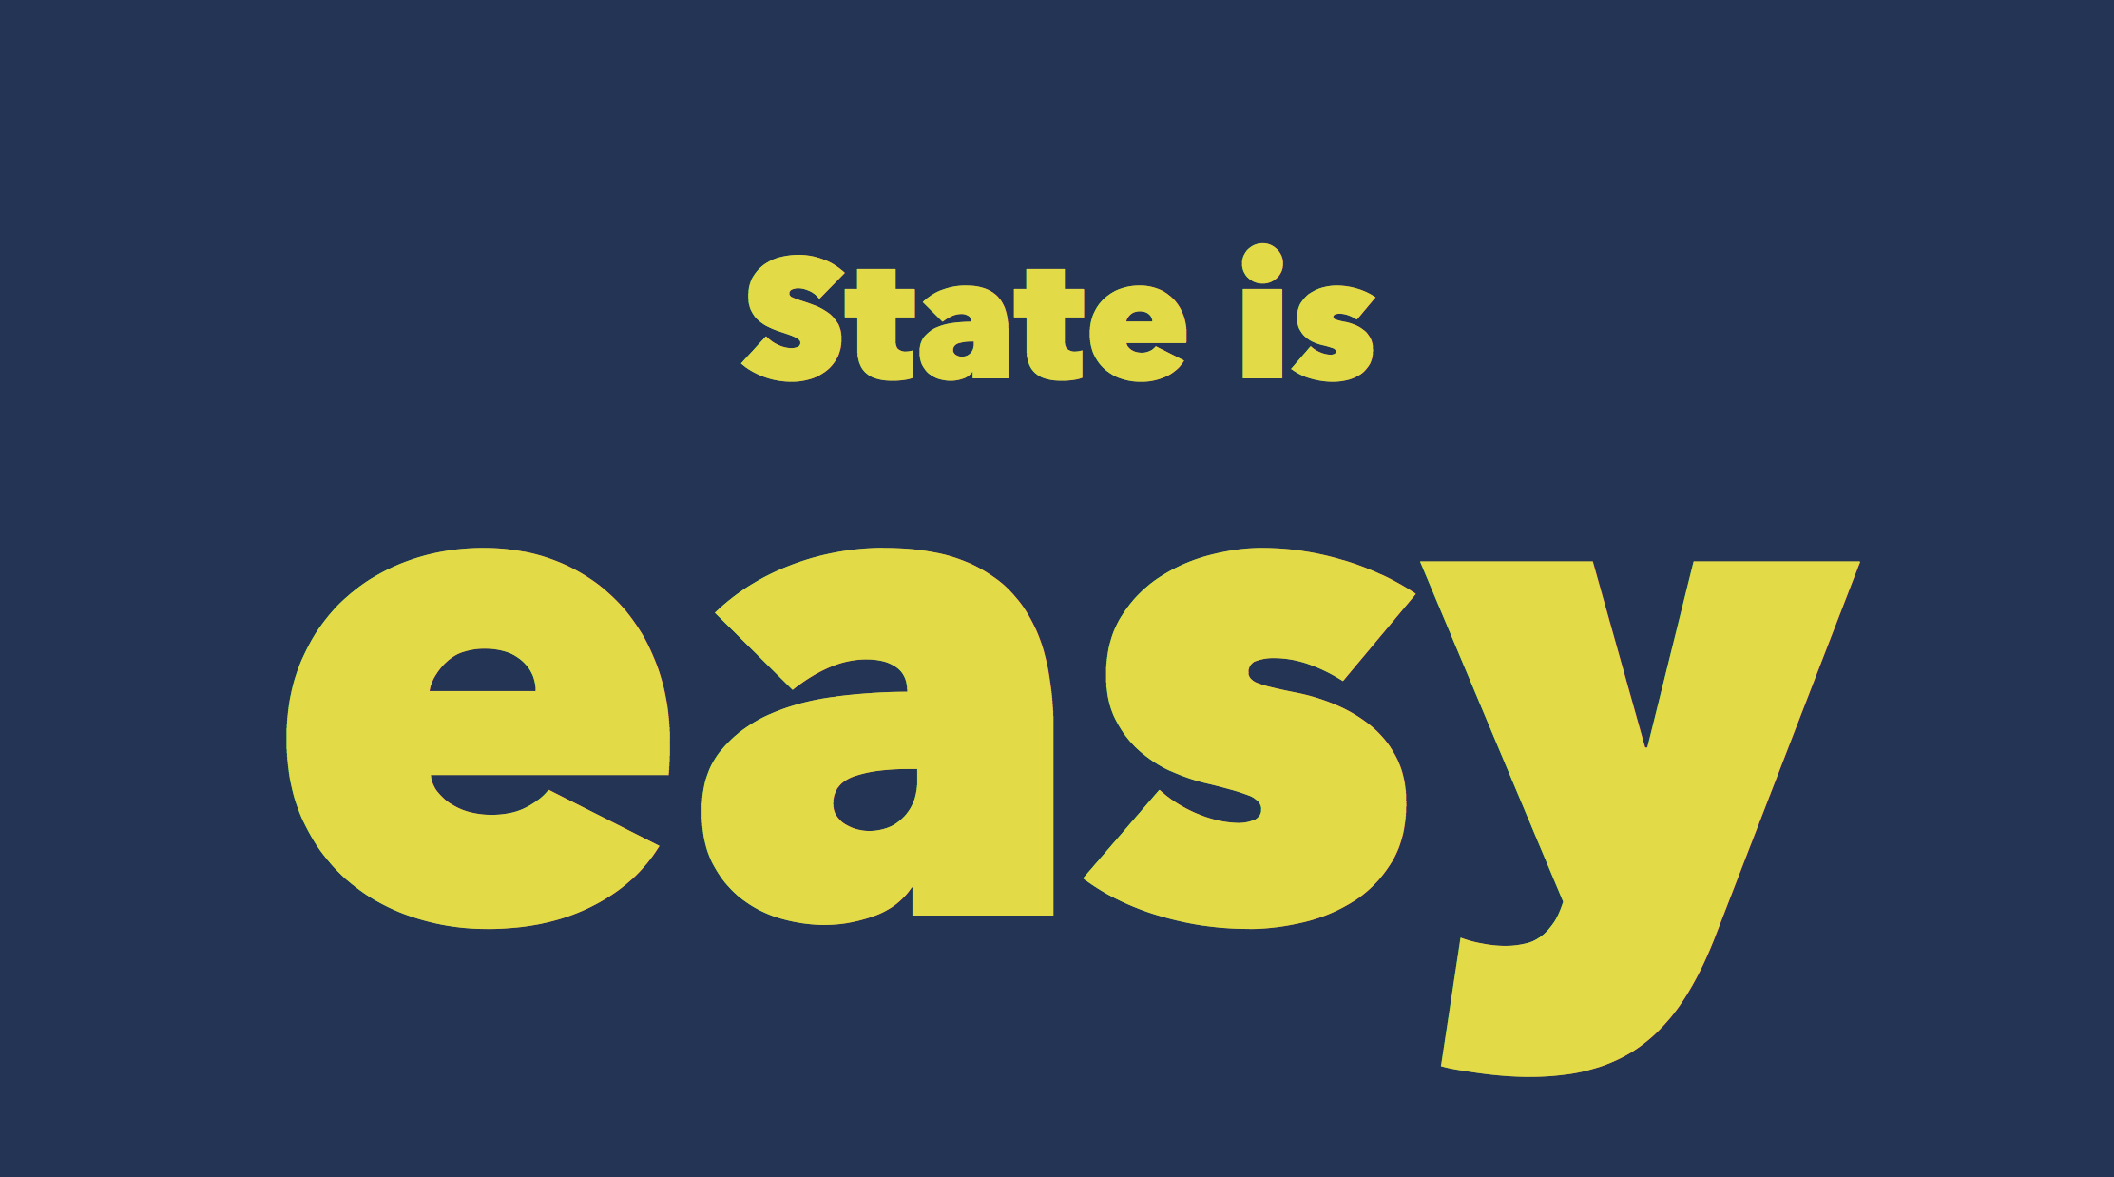

Slide 14
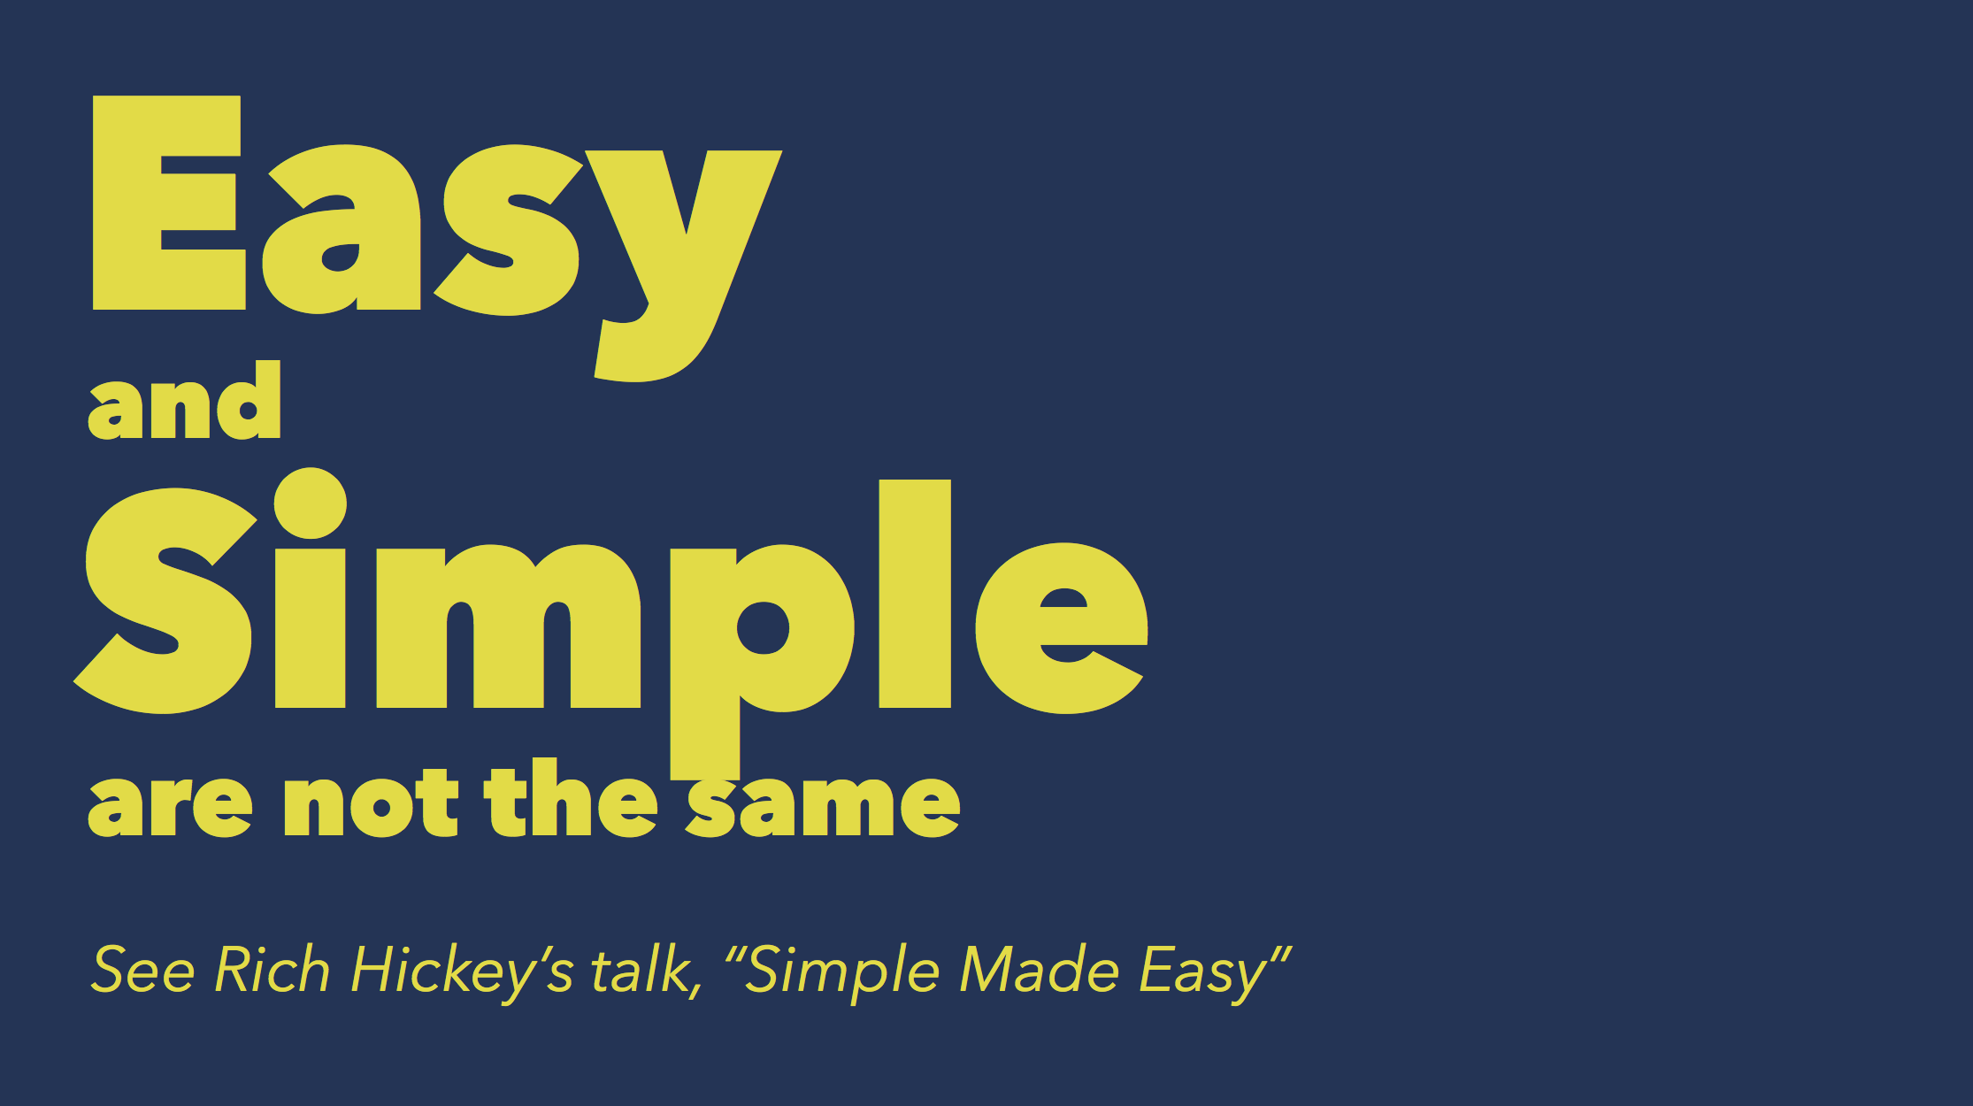

Slide 15
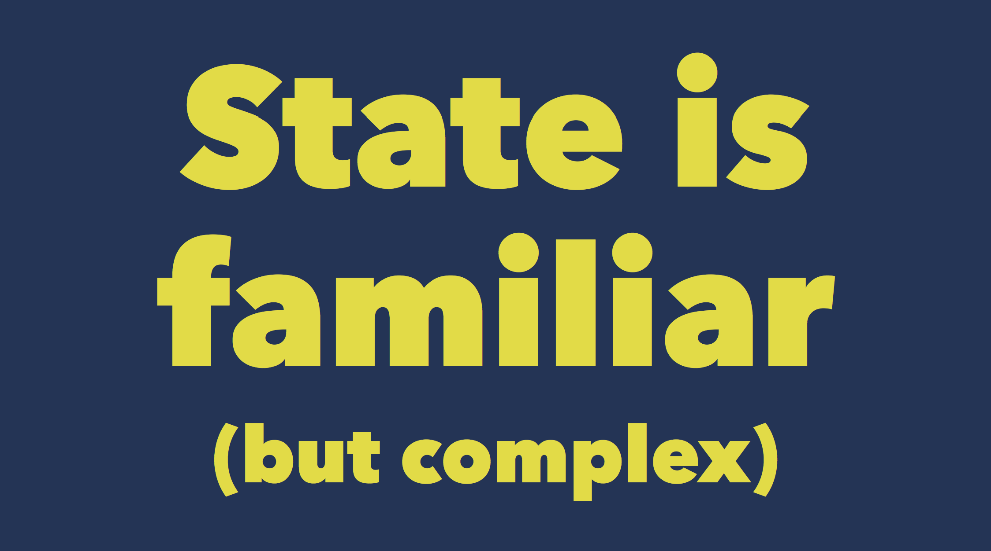

Slide 16
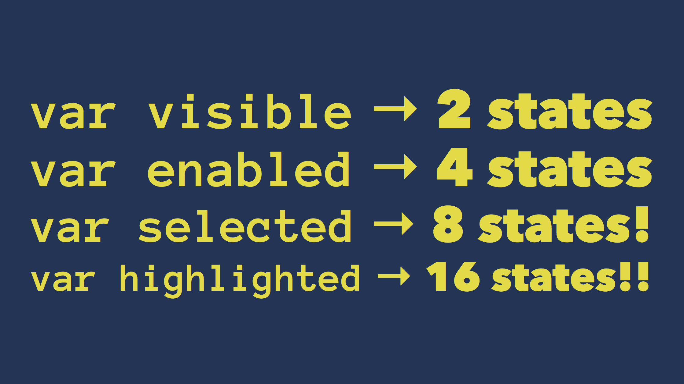

Slide 17
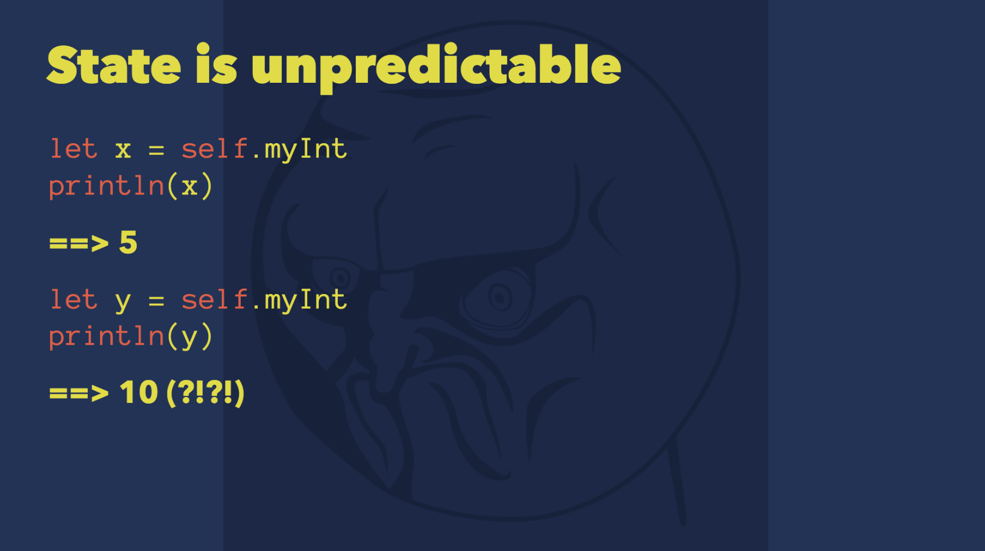

Slide 18
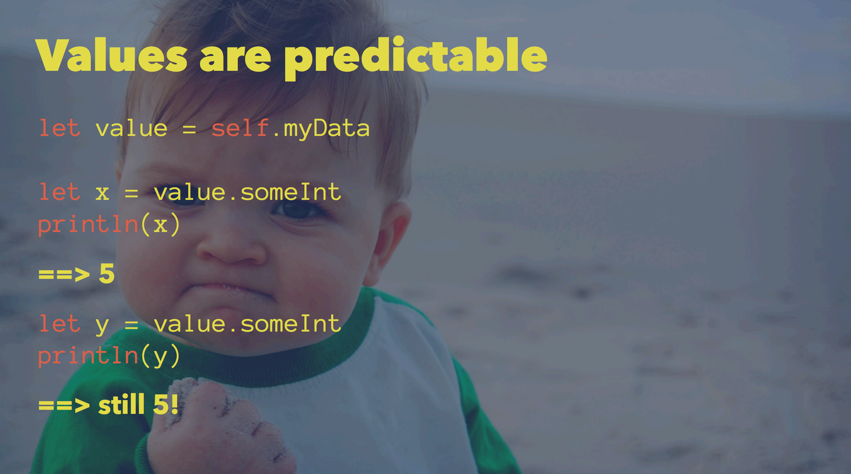

Slide 19
NO SIDE EFFECTS

Slide 20
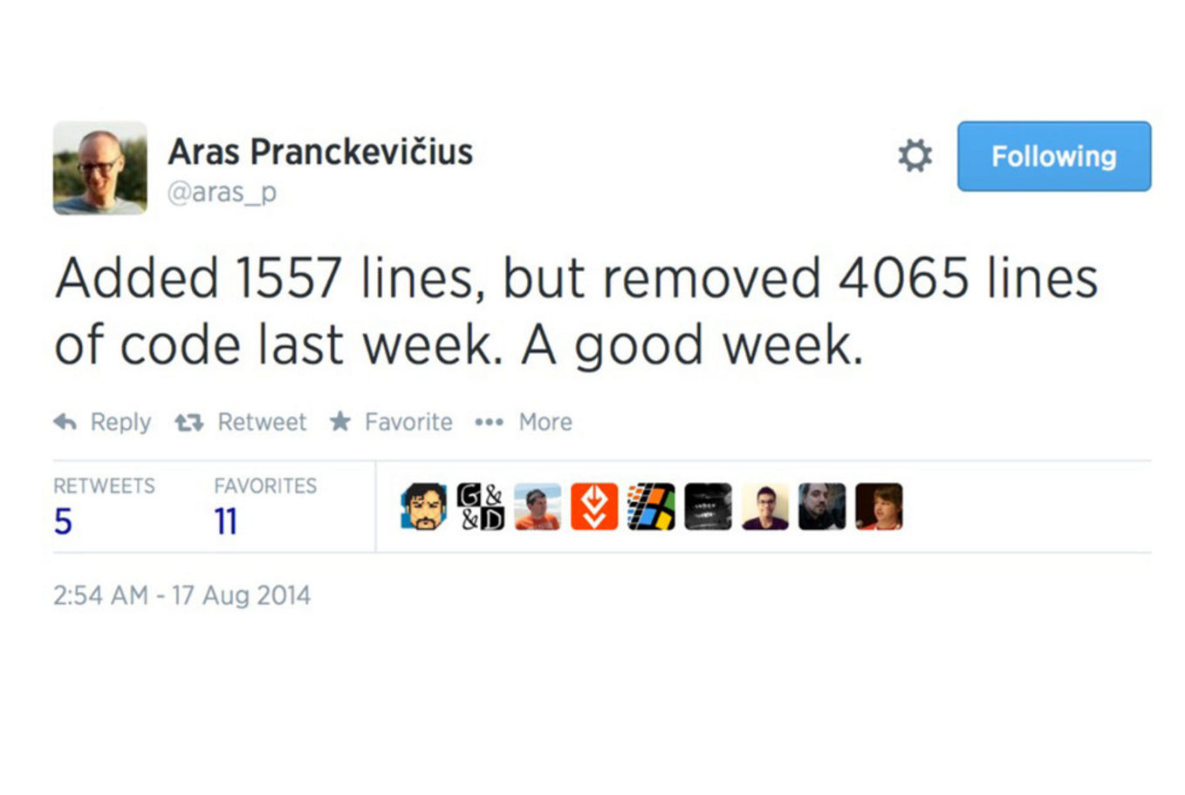

Slide 21
